Slide 1

Deplatforming and its determinants
Presentation
By Murad Ahmed

Slide 2
What is Deplatforming?
“Deplatforming” emerged as a new “form” of private censorship that is usually concerned with the internet (social media) and to lesser degree mass media
Online platforms such as Twitter have been engaging in “Deplatforming” Lebanese politicians, Burmese generals and even some right-wing US politicians for a long time [New York Times, 2021].
The most notable recent example of Deplatforming is the banning of then-US President Donald Trump from using Twitter.

Slide 3
The problem with Deplatforming
The motivating context: Deplatforming of political leaders/groups
Do people support Deplatforming in principle?
Do people view different dimensions, social, financial and technical, of Deplatforming differently or equally?
What are the determinants of the attitudes towards Deplatforming?

Slide 4
Research Approach
Online survey (Amazon MTurk) of 688 American respondents
Asking respondents to rank 6 groups from least to most liked
Treatment/control experimental design such that respondents were randomly assigned either treatment or control
Treatment is asking respondents questions about deplatforming their least liked group while control is asking respondents questions about deplatforming their most liked group in accordance with the Sullivan, Piereson, and Marcus methodology (1979, 1982)
Comparing attitudes before and after experiment as well as treatment vs control.

Slide 5
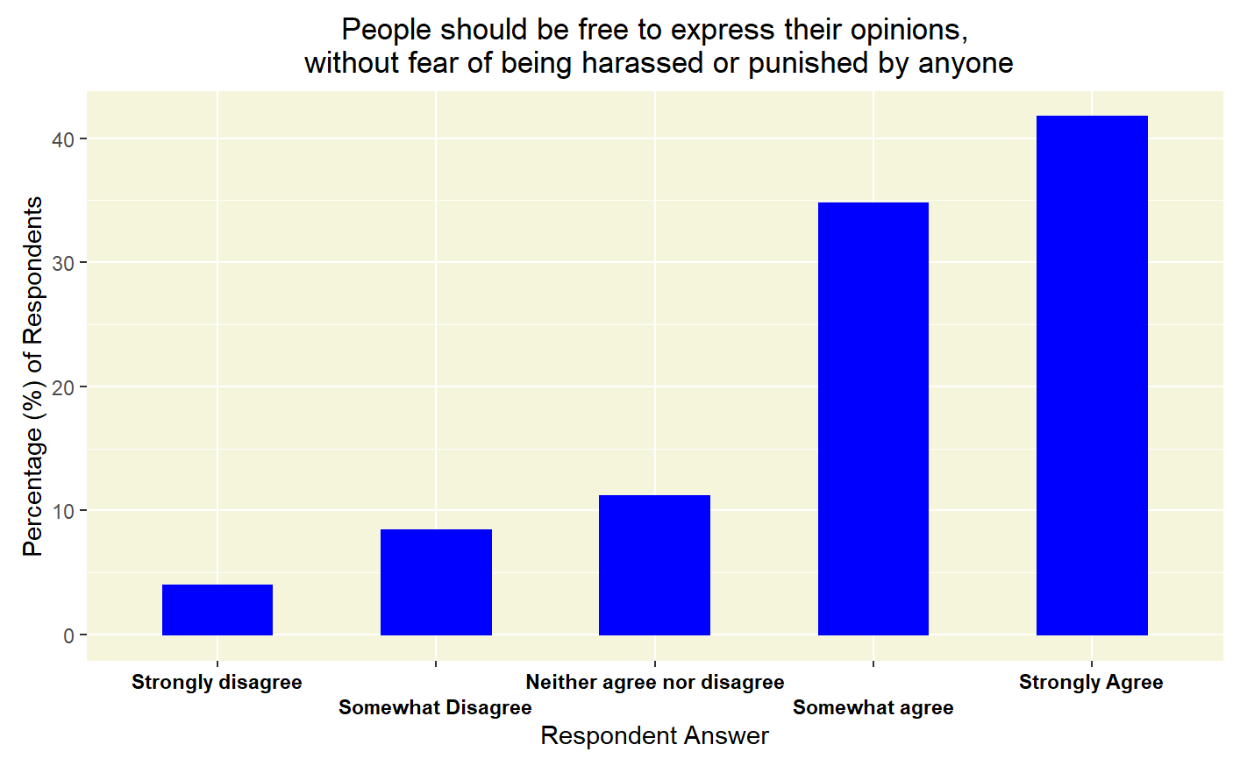
Deplatforming in principle

Slide 6
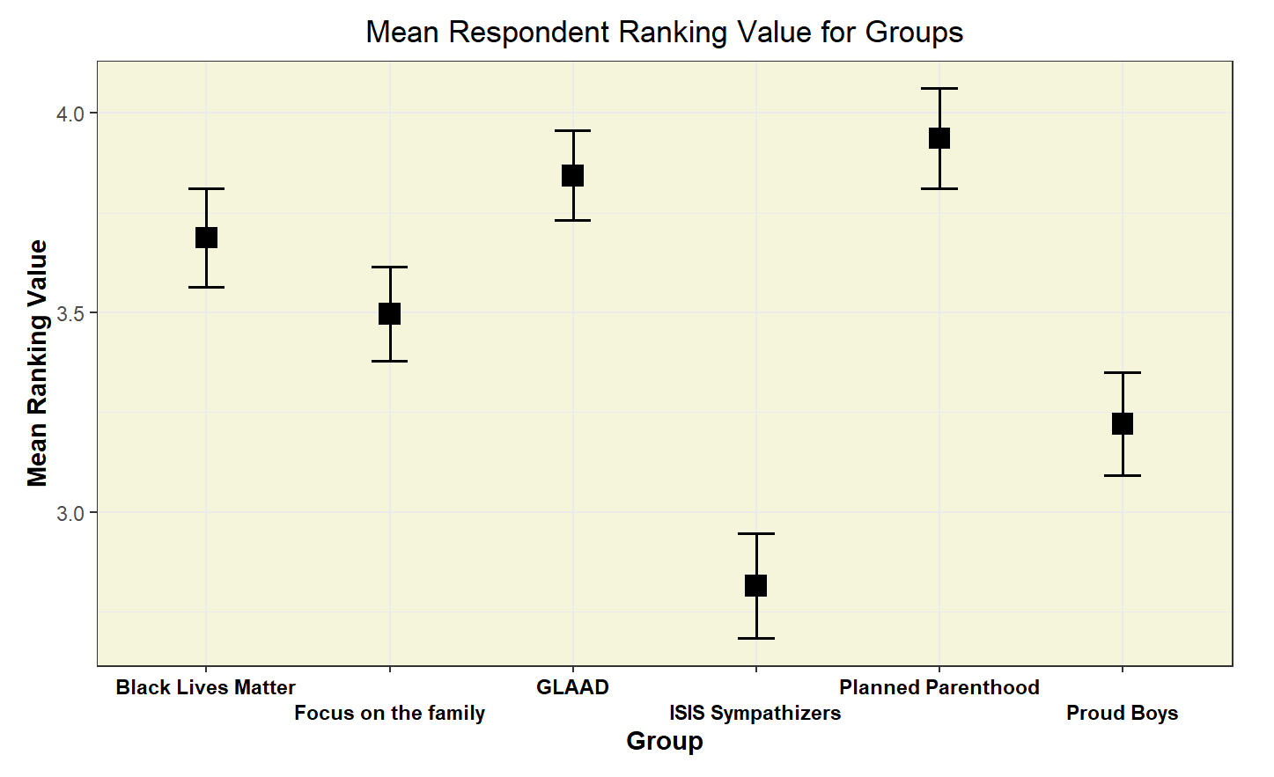
Group ranking

Slide 7
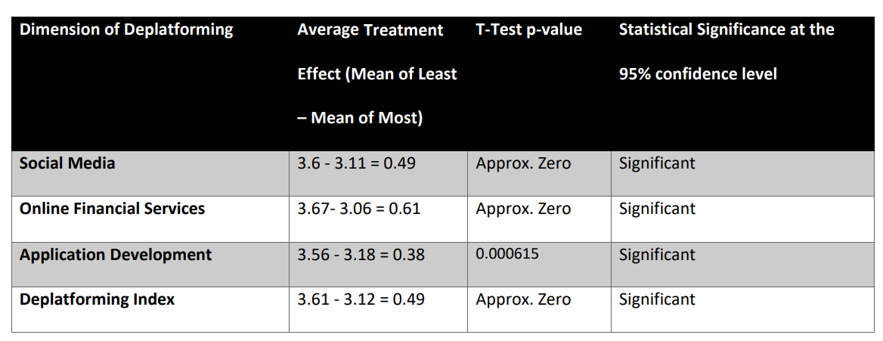
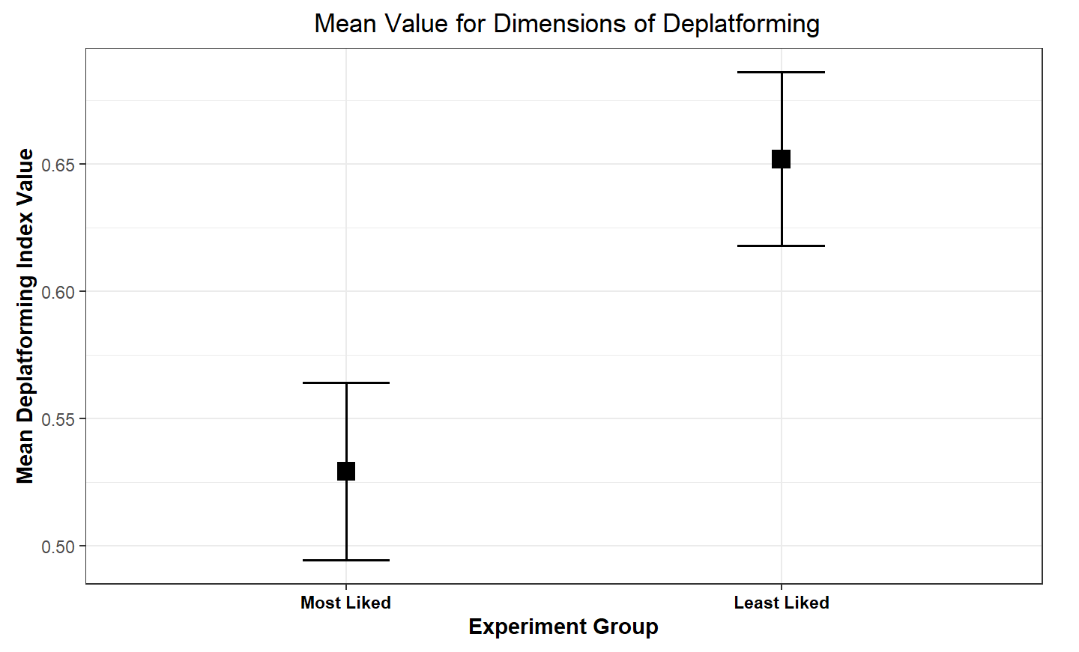
Deplatforming within the experiment

Slide 8
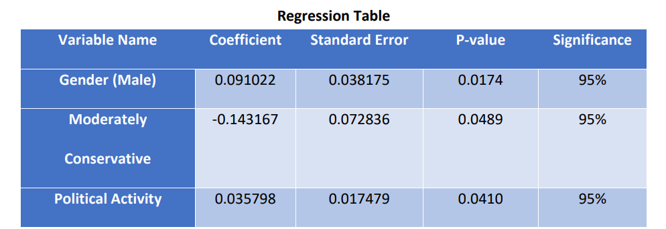
Regression Analysis
Insignificant potential determinants included in the model: age, education, political affiliation/leaning, ethnicity, religion, degree of religiousness.

Slide 9
Conclusions
People’s views on Deplatforming mainly vary according to their preference towards the deplatformed group; this contradicts their pre-treatment opposition to Deplatforming in principle
ISIS Sympathizers and the Proud Boys are the least liked groups on average
Gender, ideological leaning and the frequency of political activity are determinants of the Deplatforming index
Males and those frequently engaged in political activity are more likely to support Deplatforming, while moderate conservatives are less likely to support Deplatforming.

Slide 10
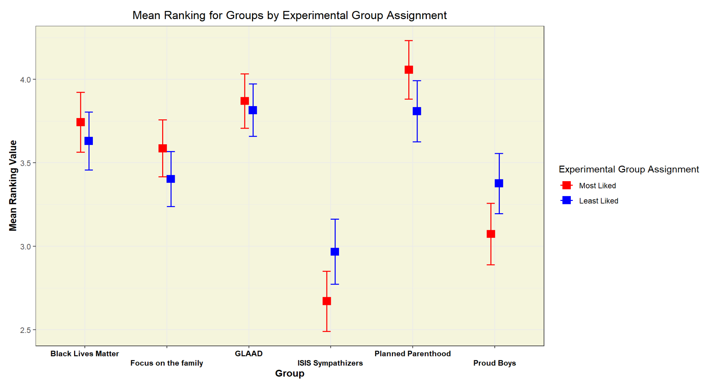
Experiment integrity test

